Slide 1


Mathematics (9-1) - iGCSE
2018-20
Year 09
Unit 08 – Answers

Slide 2
8 - Prior knowledge check
Page 653
a. 248 b. 5 c. 30 d. 4
a. 15 b. 21 c. 16 d. 63
a. 36 b. 100 c. 0.23 d. 100
1m= 100cm
1km = 1,000m
1km = 100,000cm
a. 400cm b. 6,200 m
a. B and E
b. C and F, A and D

Slide 3
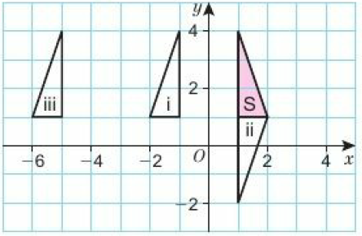
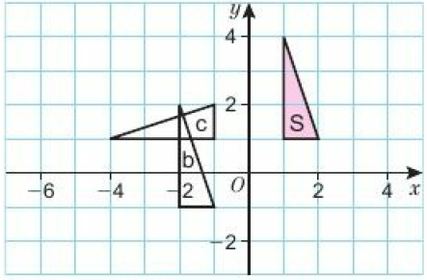
8 - Prior knowledge check
Page 653
a.
b. c.

Slide 4
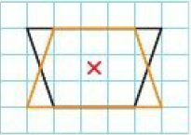
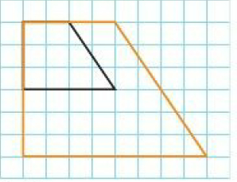
8 - Prior knowledge check
Page 653
9.
Similar
Students’ own accurate triangle
Students’ own answers

Slide 5
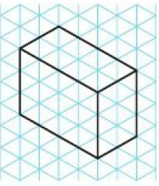
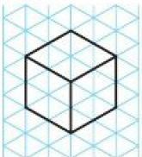
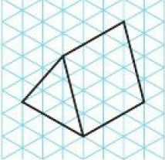
8.1 – 3D Solids
Page 653
a. e.g. b. e.g.
c. e.g.

Slide 6
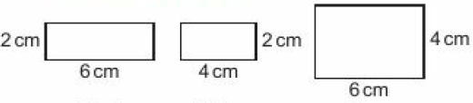
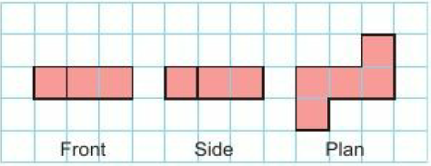
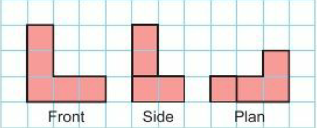
8.1 – 3D Solids
Page 653
a.
b.
c.

Slide 7
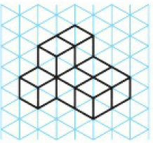
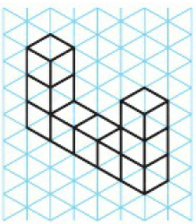
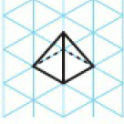
8.1 – 3D Solids
Page 654
a. e.g. b. e.g.
c. e.g.

Slide 8
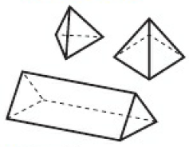
8.1 – 3D Solids
Page 654

Slide 9
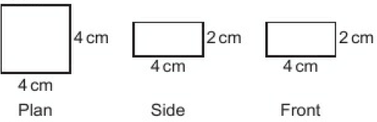
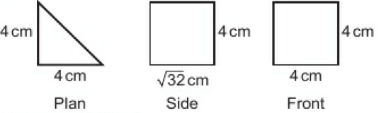
8.1 – 3D Solids
Page 654
a. 96cm²
b.
c. 64cm²
d.
Surface area 70.6cm²

Slide 10
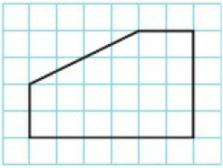
8.1 – 3D Solids
Page 654

Slide 11
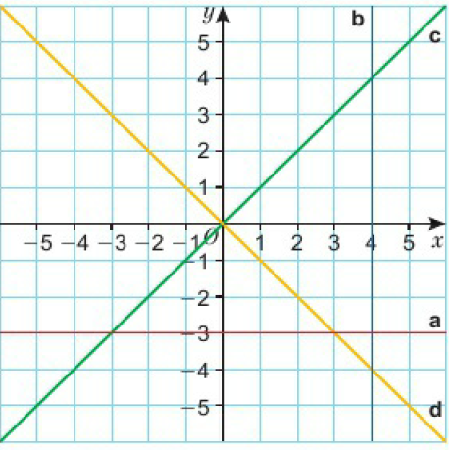
8.2 – Reflection & Rotation
Page 654

Slide 12
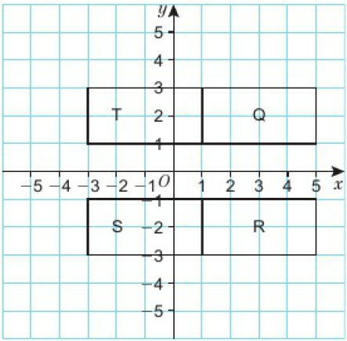
8.2 – Reflection & Rotation
Page 654
a, b, c, d
e. Reflection in the line x = 1

Slide 13
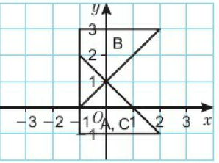
8.2 – Reflection & Rotation
Page 654
a. Reflection in the y-axis or the line x = 0
  Reflection in the line y = -1
  Reflection in the line y = -x
  Reflection in the line y = 1
a. Reflection in the line x = 3
  Reflection in the line y = -x

Slide 14
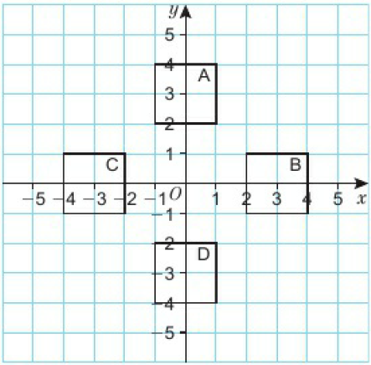
8.2 – Reflection & Rotation
Page 654
a, b, c, d
e. Reflection in the line y = -x

Slide 15
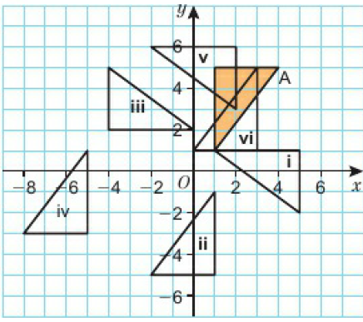
8.2 – Reflection & Rotation
Page 654

Slide 16
8.2 – Reflection & Rotation
Page 655
a Rotation 90° clockwise about (-3, 3)
  Rotation 90° clockwise about (1, 4)
  Rotation 90° anticlockwise about (3, -3)
  Rotation 180° about (-3, -3)

Slide 17
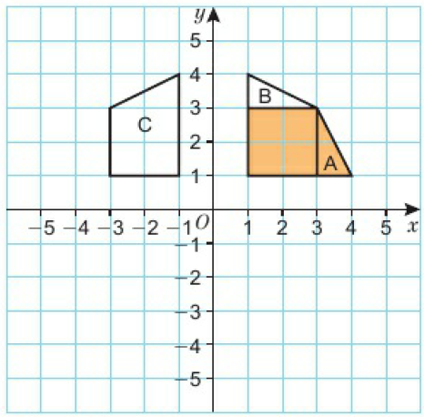
8.2 – Reflection & Rotation
Page 655
a, b, c
  Rotation 90° about (0, 0)

Slide 18
8.2 – Reflection & Rotation
Page 655
Always true, The image of point (a, b) reflected in the
x-axis and y-axis is (-a, -b), which is equivalent to a rotation of 180° about the origin.
Rotation 180° about (3, 3)

Slide 19
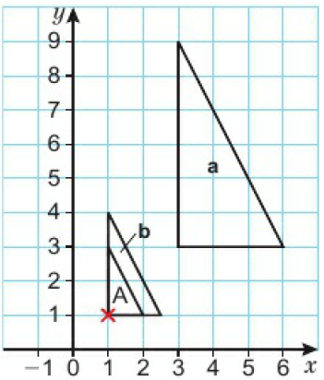
8.3 – Enlargement
Page 655
a, b

Slide 20
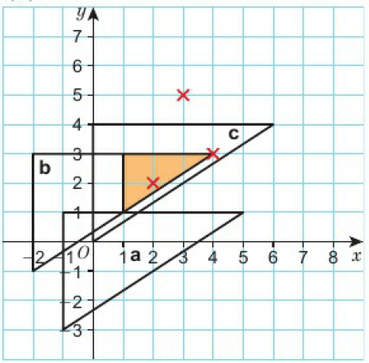
8.3 – Enlargement
Page 655
a, b, c

Slide 21
8.3 – Enlargement
Page 655
a. Scale factor 3
  Correct construction lines
  (-5, -2)
  Enlargement by scale factor 3, centre
  (-5, -2)
a. 6cm² b. 24cm² c. 54cm² d. 96cm²
e.
Shape | Scale Factor | Area of enlargement Area of A
B | 2 | 4
C | 3 | 9
D | 4 | 16

Slide 22
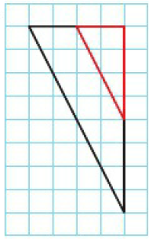
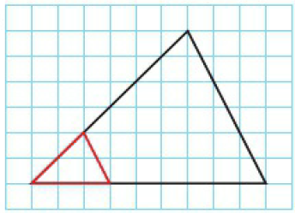
8.3 – Enlargement
Page 655
a. e.g. b. e.g.

Slide 23
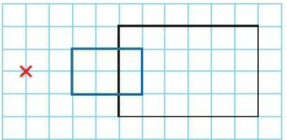
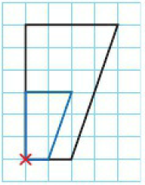
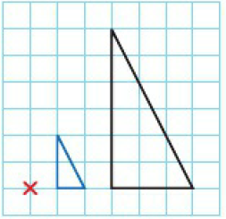
8.3 – Enlargement
Page 655
a. i.
ii. iii.

Slide 24
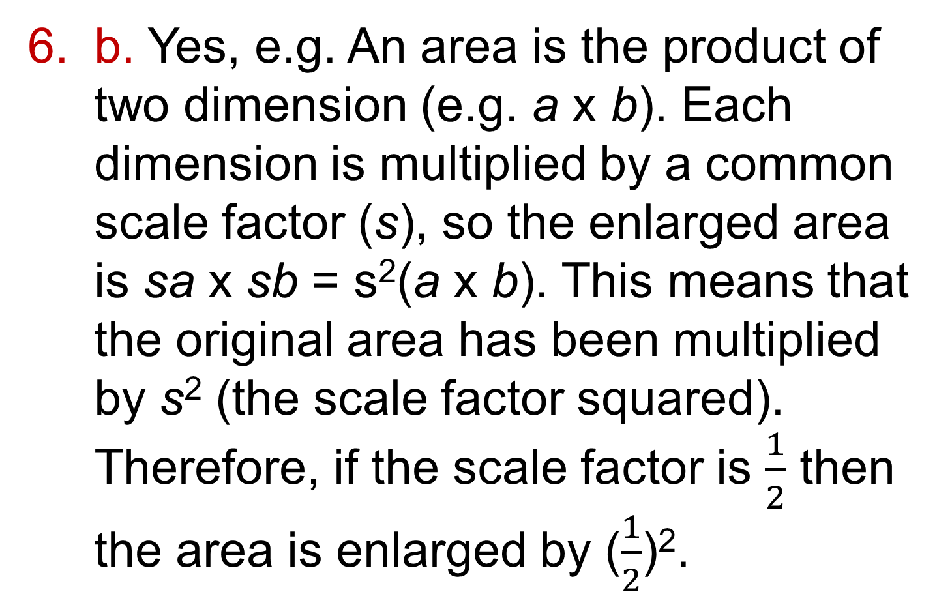
8.3 – Enlargement
Page 655
b. Yes, e.g. An area is the product of two dimension (e.g. a x b). Each dimension is multiplied by a common scale factor (s), so the enlarged area is sa x sb = s²(a x b). This means that the original area has been multiplied by s² (the scale factor squared). Therefore, if the scale factor is $\frac{1}{2}$ then the area is enlarged by ($\frac{1}{2}$)².

Slide 25
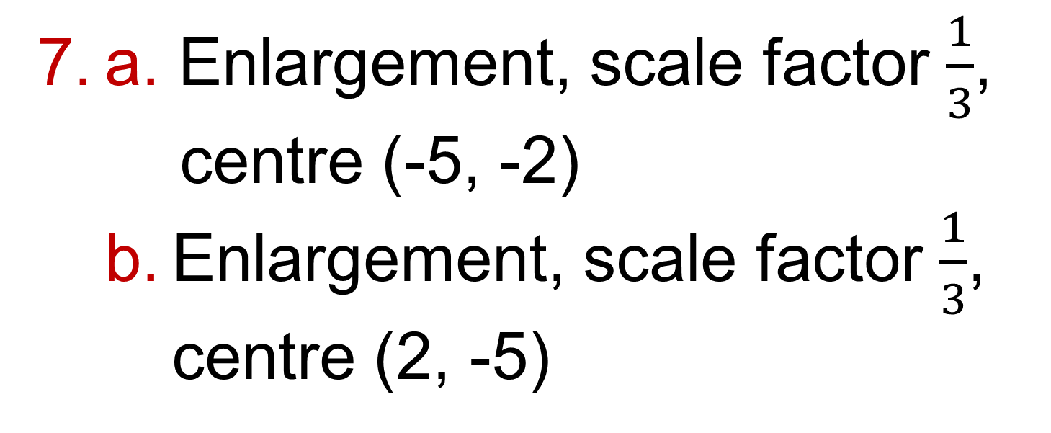
8.3 – Enlargement
Page 655
a. Enlargement, scale factor $\frac{1}{3}$, centre (-5, -2)
  Enlargement, scale factor $\frac{1}{3}$, centre (2, -5)

Slide 26
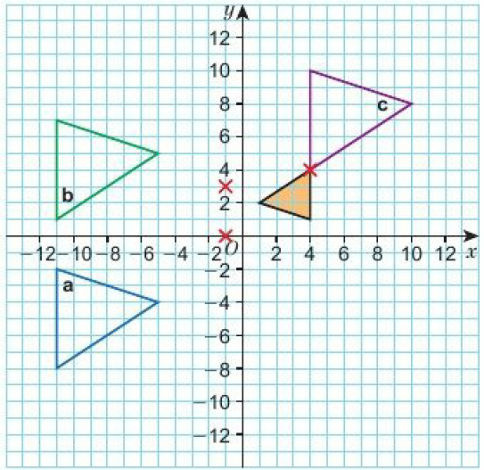
8.3 – Enlargement
Page 656

Slide 27
8.3 – Enlargement
Page 656
Enlargement, scale factor -3, centre (-2, -2)
Jamie is incorrect. Enlargements with scale factors between -1 and 1 make a shape dmaller than original shape.
Enlargement, scale factor -3, centre (-2, -2)

Slide 28
8.4 – Translations and Combinations of Transformations
Page 656
A 2 square right, 2 squares up
B 2 squares left, 2 squares up
C 2 square left, 2 squares up
D 1 square left, 2 squares up
E -2 squares left, 5 squares down

Slide 29
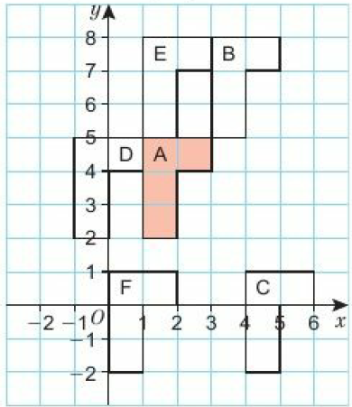
8.4 – Translations and Combinations of Transformations
Page 656

Slide 30
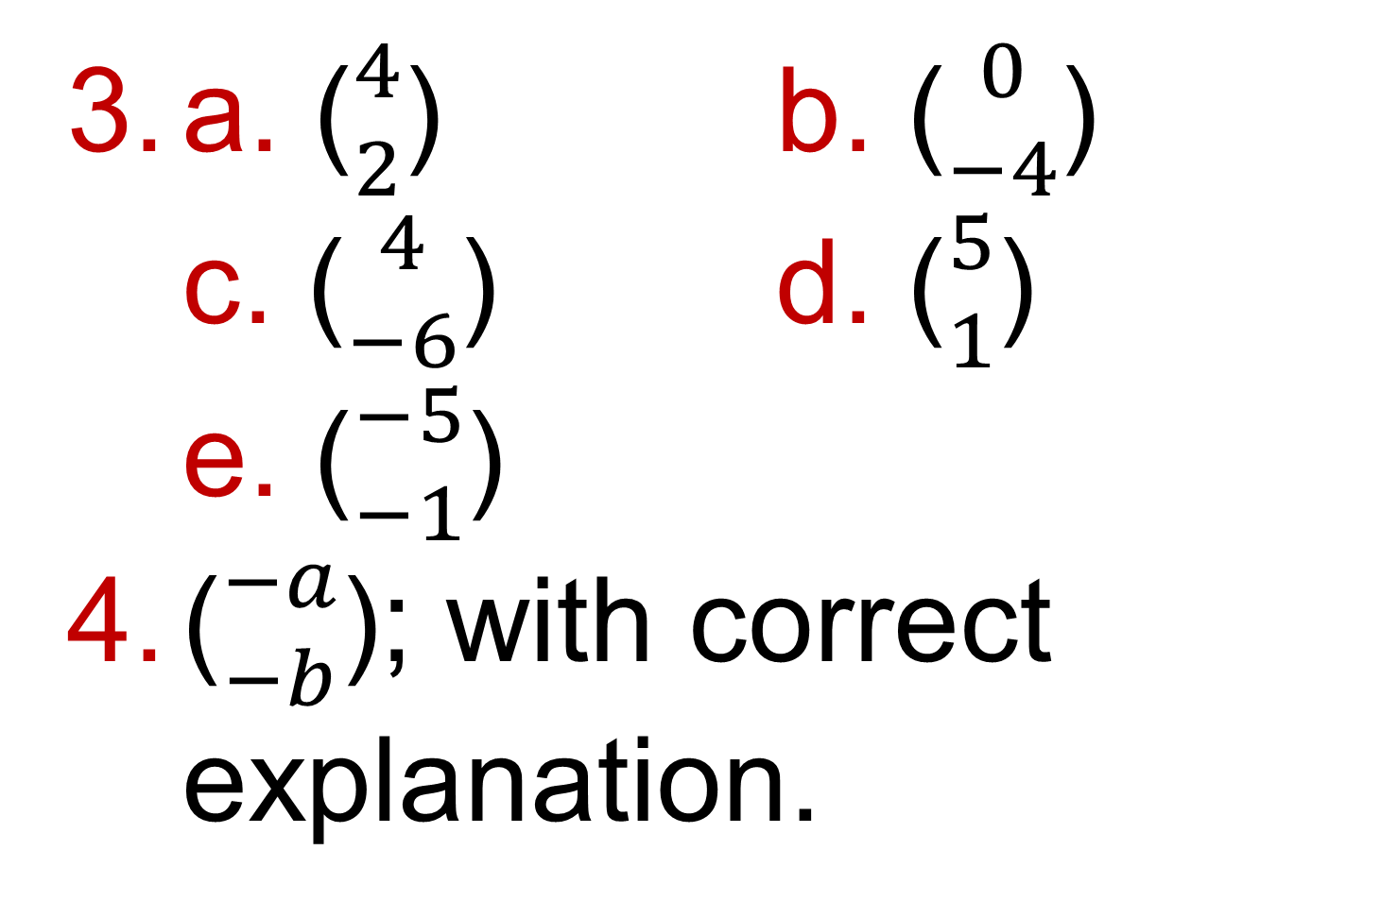
8.4 – Translations and Combinations of Transformations
Page 656
a. (${4 \atop 2}$) b. (${0 \atop −4}$)
c. (${4 \atop −6}$) d. (${5 \atop 1}$)
e. (${−5 \atop −1}$)
(${−a \atop −b}$); with correct explanation.

Slide 31
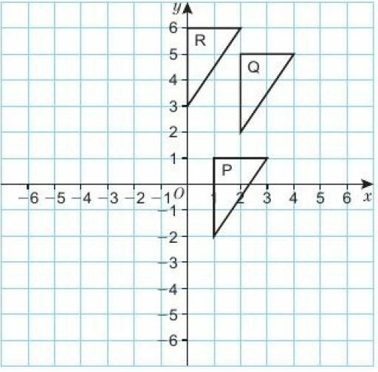

8.4 – Translations and Combinations of Transformations
Page 656
a, b
c. (${−1 \atop 5}$)

Slide 32
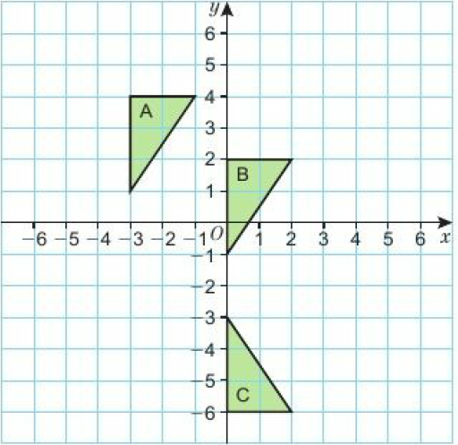
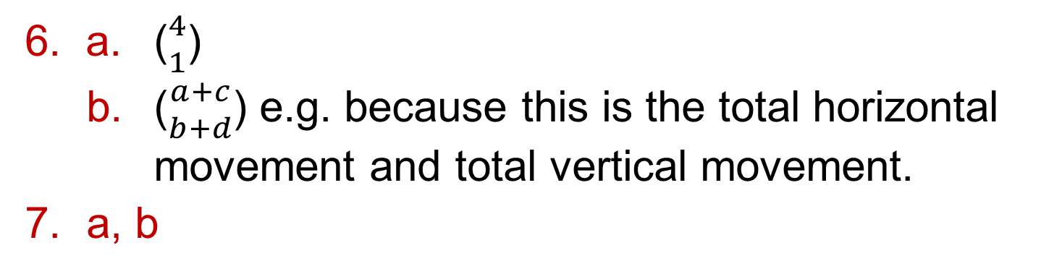
8.4 – Translations and Combinations of Transformations
Page 656
a. (${4 \atop 1}$)
  (${a+c \atop b+d}$) e.g. because this is the total horizontal movement and total vertical movement.
a, b

Slide 33
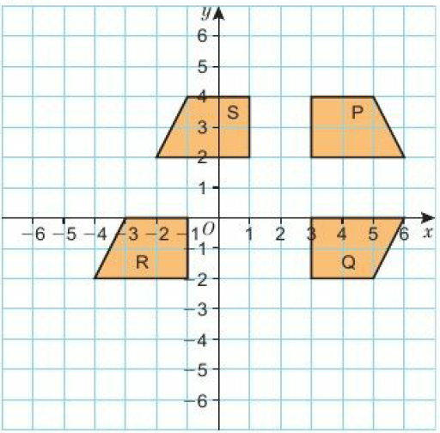
8.4 – Translations and Combinations of Transformations
Page 656
a, b, c
  Reflection in the line x = 2

Slide 34
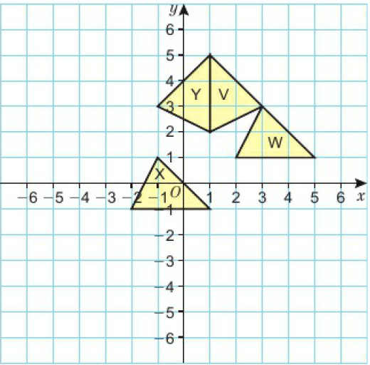
8.4 – Translations and Combinations of Transformations
Page 657
a, b, c
  Reflection in the line x = 1

Slide 35
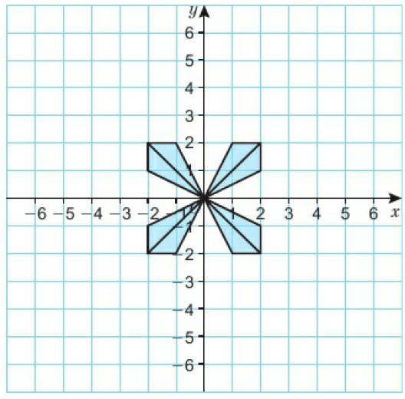
8.4 – Translations and Combinations of Transformations
Page 657
a, b, c
  Enlargement scale factor 3, centre (0, 0)

Slide 36
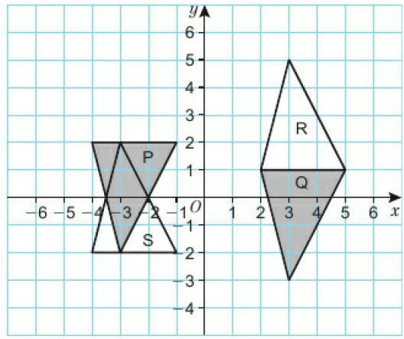

8.4 – Translations and Combinations of Transformations
Page 657
a. (${6 \atop −1}$)
  Reflection in line y = 1

Slide 37
8.4 – Translations and Combinations of Transformations
Page 657
Adam's statement is not always true. When a shape is enlarged, the image and the original are similar but not congruent.

Slide 38
8.5 – Bearings and Scale Drawings
Page 657
a. 20m b. 2.5cm
a. Accurate scale drawing of right-angled triangle with base 6 cm, hypotenuse 10 cm
  36m
a. 072° b. 255°
Bearing of 285° accurately drawn
a. 1cm:120m b. i. 360m ii. 600m
c. Answers between 4 and 4.24 minutes
a. 5km b. 3 km c. 1.25km d. 0.25km
a. 10cm b. 5cm c. 4cm.

Slide 39
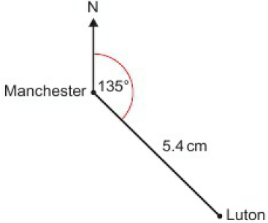
8.5 – Bearings and Scale Drawings
Page 657
a. 2.5km b. 16cm
a. i. 130km ii. 136km b. Sligo
a. Accurate scale drawing, with AB = 5cm
b. AC = 67m, CB = 78m

Slide 40
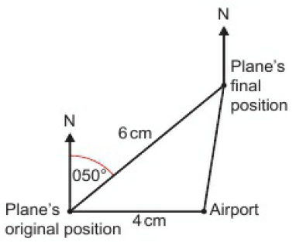
8.5 – Bearings and Scale Drawings
Page 657
a.
b. 188⁰

Slide 41
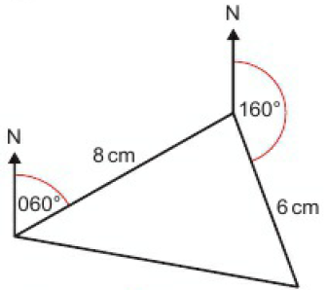
8.5 – Bearings and Scale Drawings
Page 657
a.
b. 27km c. 280⁰

Slide 42
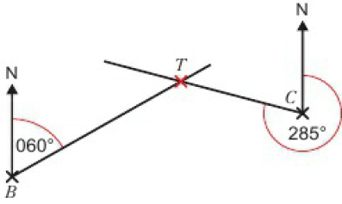
8.5 – Bearings and Scale Drawings
Page 657
323⁰
a. 260⁰ b. 050⁰

Slide 43
8.5 – Bearings and Scale Drawings
Page 658
Accurate drawing of the triangle
Accurate drawing of the triangle
Accurate drawing of the triangle
a, b, c Accurate drawings of the triangles
Accurate drawing of an equilateral triangle with side 6.5 cm
The sum of the two shorter sides is less than the longest side so the triangle will not be possible.

Slide 44
8.6 – Constructions 1
Page 658
Accurate drawing of triangle with sides of length 5cm, 15 cm and 17 cm (for real-life sides of 100cm, 300cm and 340cm respectively)
Accurate drawing of triangle with sides of length 5.5cm, 5.5cm and 10cm (for real-life sides of 11m, 11m and 20m respectively)

Slide 45
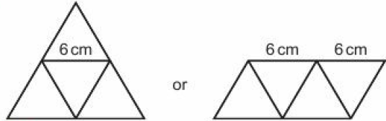
8.6 – Constructions 1
Page 658
Accurate net with sides of length 6cm.
a, b Perpendicular bisector of line segment AB of length 7 cm drawn accurately
  AP is the same distance as BP.

Slide 46
8.6 – Constructions 1
Page 658
a, b Perpendicular bisector accurately constructed of 2 points, S and T, 10cm apart. The perpendicular bisector shows possible positions of the lifeboat.
a, b, c Perpendicular bisector from point P to the line AB accurately constructed.
a, b, c Perpendicular at point P on a line accurately constructed.
a. Shortest distances to sides accurately drawn,
  2.5m c. 10 seconds

Slide 47
8.7 – Constructions 2
Page 658
a. Accurate drawing of a triangle with sides 10cm, 8cm,
  Right-angled triangle
a. Accurate construction of an equilateral triangle with b 60°
Angles accurately drawn and bisected A
a. Accurate construction of 90° angle
  Accurate construction of 45° angle
a. Accurate construction of 60° angle
  Accurate construction of 30° angle

Slide 48
8.7 – Constructions 2
Page 658
a. Accurate construction of 120° angle
a. Accurate scale drawing with sides 3cm and 5cm
  Accurate construction of angle of 30°
  115m²
a. Accurate scale drawing with pole height 4cm, top guy length 4.5cm and angle CBA 63°
  2.4m c. 27.6m

Slide 49
8.7 – Constructions 2
Page 658
a. Accurate construction of triangle
      Accurate construction of line perpendicular to AB that passes through C
      16 cm
Accurate scale drawing

Slide 50
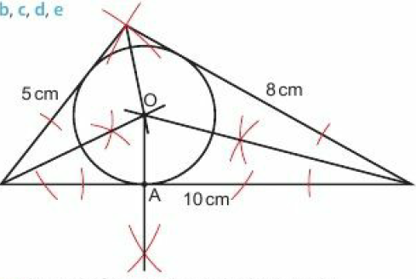
8.7 – Constructions 2
Page 658
a. Accurate
construction of
triangle
  c, d, e
  The circle fits
  exactly inside
  the triangle.
a, b, c Construction of regular hexagon in a circle
  Hexagon
Construction of regular octagon in a circle with radius 5

Slide 51

8.8 – Loci
Page 658
Circle
Sketch of a circle with radius marked 5m

Slide 52

8.8 – Loci
Page 658
a, b

Slide 53

8.8 – Loci
Page 658
a, b, c

Slide 54

8.8 – Loci
Page 658

Slide 55

8.8 – Loci
Page 659
a, b

Slide 56

8.8 – Loci
Page 659

Slide 57


8.8 – Loci
Page 659

Slide 58

8.8 – Loci
Page 659

Slide 59

8.8 – Loci
Page 659
a.
b. 16πkm² = 50.3km²

Slide 60
8 – Problem-Solving
Page 659
One method would be as follows:
Construct a perpendicular bisector to establish 0° and 90°.
Construct an equilateral triangle with a vertex at the origin to find 60°.
Bisect the 60° angle to create a 30° angle.
Bisect the existing angles to create 15°, 45° and 75°.
Repeat on the other side of 90° to extend this up to 180°.

Slide 61
8 – Problem-Solving
Page 659
Construct the perpendicular bisectors of the sides of the regular hexagon and place a point where each of these bisectors meets the circle. Join these additional six points with the vertices of the hexagon to construct a regular dodecagon.
Square correctly constructed.

Slide 62
8 – Problem-Solving
Page 659
Start by constructing a square, then find the centre of the square and draw the circle which goes through all of its vertices.
Repeat the method described above on the square to construct a regular octagon.

Slide 63
8 – Problem-Solving
Page 659
If you start with a square you can construct any polygon where the number of sides is a power of 2 (8 sides, 16 sides, 32 sides...).
If you start with a hexagon you can construct any polygon where the number of sides is 3 multiplied by a power of 2 (12 sides, 24 sides, 48 sides...).

Slide 64


8 – Check-Up
Page 659
a. Reflection in the line y = x
  Rotation 90° anticlockwise about (4, -1)
  Translation (${−4 \atop 5}$)

Slide 65

8 – Check-Up
Page 659
a. Enlargement scale factor 2, centre (-3, 5)
  Enlargement scale factor $\frac{1}{2}$, centre (-3, 3)
  Enlargement scale factor -1, centre (0, -2.5)

Slide 66

8 – Check-Up
Page 659
a, b, c
d. Reflection in the line x = -1

Slide 67


8 – Check-Up
Page 659
4cm
290⁰
a.
  275⁰

Slide 68

8 – Check-Up
Page 659
Perpendicular bisector accurately constructed on a line of length 10cm
Angle accurately
bisected
a, b
Regular polygons with these numbers of sides: 3, 4, 5, 6, 8, 10, 12, 15, 16, 17, 20, 24, 30, 32, 34, 40, 48, 51, 60, 64, 68 …

Slide 69

8 – Strengthen
Page 659
Transformations
a, b
  The triangle on tracing paper when folded in the line reflection becomes the image.

Slide 70

8 – Strengthen
Page 659
a, b, c

Slide 71

8 – Strengthen
Page 659
Shape A is reflected in the line y = x to give the image B.
a. (${3 \atop 2}$) b. (${5 \atop 1}$) c. (${2 \atop −1}$) d. (${−3 \atop 2}$)
e. (${−6 \atop −3}$) f. (${3 \atop −4}$)
a. 3 right, 1 up or (${3 \atop 1}$)
b. 5 left or (${−5 \atop 1}$)
c. 2 left, 3 down or (${−2 \atop −3}$)
d. 6 left, 6 down or (${−6 \atop −6}$)
C

Slide 72

8 – Strengthen
Page 659
a. Rotation of 90°clockwise about (0,0)
  Rotation of 180° about (0, 2)
  Rotation of 90°anticlockwise about
  (4, -1)
a, b, c

Slide 73

8 – Strengthen
Page 659

Slide 74

8 – Strengthen
Page 659

Slide 75
8 – Strengthen
Page 659
Rotation angle, direction and centre of rotation
Translation horizontal movement and vertical movement (or translation vector) Enlargement scale factor and centre of enlargement

Slide 76

8 – Strengthen
Page 659
Drawings and Bearings
a. B b. A c. C
a. 1km b. 2.5km
c. 6km d. 4.25km

Slide 77
8 – Strengthen
Page 659
a. 3 cm b. 7cm
c. 10cm d. 7.5cm
x = 65°(interior angles on parallel lines sum to 180°)
y = 360 - x (angles add at a point sum to 360°)
= 360 - 65 = 295°
Bearing of A from B is 295°

Slide 78

8 – Strengthen
Page 661
a, b
  i. 30km ii. 301⁰

Slide 79
8 – Strengthen
Page 661
Constructions and Loci
Accurate construction of a triangle with sides of length 10cm, 7cm, 6cm
Accurate construction of a triangle with sides of length 7cm, 8cm, 9cm
Accurate construction of the perpendicular bisector of a line of length 12cm

Slide 80

8 – Strengthen
Page 661
Accurate construction of the perpendicular bisector of a line of length 7cm
Accurate construction of angle bisector of 70° angle
Accurate construction of angle bisector of 100° angle
a. b. Circle
  Points that are equidistant from a centre make a circle.

Slide 81

8 – Strengthen
Page 661
a, b, c .

Slide 82

8 – Extend
Page 661
a.
  Rotation 180°
  about the origin
  Yes, it always works.
Enlargement, scale factor -2, centre of enlargement (-1, 0)

Slide 83

8 – Extend
Page 661
a, b, d
  When points are
  reflected in the
  x-axis, the
  y-coordinate is
  multiplied by -1
  When points are
  reflected in the
  y-axis, the x-coordinate is multiplied by -1
  i. (p, -q) ii. (-p, q) iii. (-p, -q)

Slide 84

8 – Extend
Page 661
a, b, c
d. i. (q, p) ii. (-q, -p) iii. (-p, -q)
(-2, -1), (-4, -1), (-3, -5), (-5, -5)

Slide 85

8 – Extend
Page 661
Reflection in y = x followed by reflection in the y-axis
Reflection in y = -x followed by reflection in the x-axis
a, d
b. y = -x + 2 c. 1

Slide 86

8 – Extend
Page 661
a.
x = 180 – a (interior angles in parallel
lines sum up to 180⁰)
y = 360 - (180 - a) (angles at a point sum to
= 180 + a 360°)
  (a - 180)⁰

Slide 87
8 – Extend
Page 661
a. 60⁰
  b, c Accurate construction of a hexagon.
  Accurate construction of a triangle with area of 30cm²
  a. Sphere b. Circle

Slide 88

8 – Extend
Page 662
a.
b. 88cm²
Two correct transformations, e.g. 90° clockwise rotation about (0.5, 1.5), followed by a reflection in x = -0.5, or translation (-2,0) followed by reflection in y = -x

Slide 89

8 – Extend
Page 882
a, b
b. (1.7, 4.7) and (-4.7, -1.7)

Slide 90
8 – Unit Test
Page 882
Sample student answer
Student B gives the best answer. Student A has not given the direction or centre of rotation. Student C has given two transformations.
The question asks for a single transformation.

